Slide 1
Medical Document Tracker
ACU School of Nursing uses an electronic Medical Document Management system to file all of your clinical requirements. This makes the process of collecting documents much more efficient for the school and the clinical facilities. As an added benefit, it gives you constant access to your information from any location and also will notify you if a clinical requirement is about to expire or needs to be updated.
In order to secure your place in the cohort and to be added to the roster then you must set up your Medical Document Tracker by April 20th for Fall entry and October 20th for Spring entry.

Slide 2
Castle branch document tracker

Slide 3
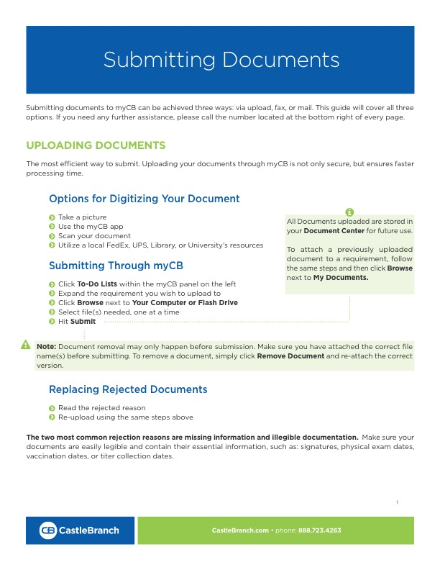

Slide 5
