Slide 1
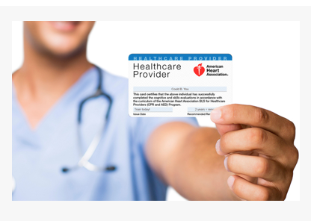
American Heart association CPR Certification for healthcare professionals
As the world leader in CPR, first aid and emergency cardiovascular care (ECC) training and education, the American Heart Association offers a variety of options for you to learn lifesaving skills. Find a local training center offering classes for family and friends, employees, or healthcare providers.

