Slide 2
Paying for College

Slide 3
Learning Outcomes
Develop an understanding of realistic options to pay for school
Understand financial aid and scholarship process
Identify net price vs. sticker price
Understand Career outlook and ROI
Notes:
Today’s session will focus on a few different learning outcomes. We understand that students may have many questions/concerns related to the cost of education. Through this session our goal is to help students develop an understanding of realistic options to pay for school, understand financial aid and scholarships process, identify net price vs. sticker price, and understand career outlook and ROI.

Slide 4
Where do I start?
Know the cost
Complete the FAFSA
Review university scholarships
Research outside scholarship options
Find a good paying summer job
Know your loan options
Notes:
A question we get often from students looking to make a plan to pay for school is where do I start. This can be a very confusing step as paying for college can seem very overwhelming. The first step in paying for school is to know the cost of your education. Schools have what is called a cost of attendance that provides a breakdown of the estimated costs associated with attending their school over a nine month academic year. Once you know the cost of your education, the next step is to utilize all aid avenues. Apply to the FAFSA as early as possible in order to receive your eligibility in federal, state, and institutional aid. Keep in mind, all students may not qualify for a need based award, however, all students can get federal loans regardless of need. After completing the FAFSA, take some time doing research on university scholarship options. There are scholarships offered by the university as well as individual majors and colleges. Once you have exhausted all options on campus, look into as many scholarship options outside the university. We encourage our students to dedicate 10 hours a week to applying for scholarships.You will also need to work as much as you can during the summer to save up proactively for your upcoming semester. Lastly, know all loan options available to help with paying for school.

Slide 5
Breaking down the cost

Slide 6
Undergraduate Students
Estimated Traditional Cost of Attendance
Tuition & Fees | $37,800
Room & Board | $11,348
Books & Supplies | $1,250
Transportation | $1,450
Personal Expenses | $1,872
Federal Student Loan Fees* | $70
Total | $53,740
Notes:
So how much is college? The cost of attendance at ACU for the 2020-2021 year is $53,740. The first three parts of the cost of attendance are costs that each student will have to pay in some way or form. For first and second year students, these charges will be owed directly to the university. In years three and four, room and board will be paid our differently as many students move of campus at that time. The remaining three expenses are charges to consider, but will look different for each student. For example, students who have cars will need to budget for gas and car maintenance costs. For students that do not drive, they will have to budget for any costs associated with getting around town as needed, and getting home at the beginning and end of the semester. Personal expenses encompass any remaining personal costs associated with a student living during the school year. This includes, personal hygiene products, items for dorm, school supplies, etc.

Slide 7
COA and Block Tuition
Notes:
Please watch this brief video regarding your COA and Block tuition

Slide 8
Financial Aid options

Slide 9
What is the FAFSA?
To apply for federal student aid, such as federal grants, work-study, and loans, you need to complete the Free Application for Federal Student Aid (FAFSA). Completing and submitting the FAFSA is free and easier than ever, and it gives you access to the largest source of financial aid to pay for college or career school.
In addition, many states and colleges use your FAFSA information to determine your eligibility for state and school aid, and some private financial aid providers may use your FAFSA information to determine whether you qualify for their aid.
Notes:
ACU encourages all students to complete the FAFSA yearly to maximize their aid eligibility.

Slide 10
Who is eligible to apply?
Federal Student Aid eligibility requirements:
https://studentaid.gov/understand-aid/eligibility/requirements#basic-eligibility-criteria
Notes:
There are a few requirements in order to be eligible for federal aid. These requirements can be provided on the student aid website.

Slide 11
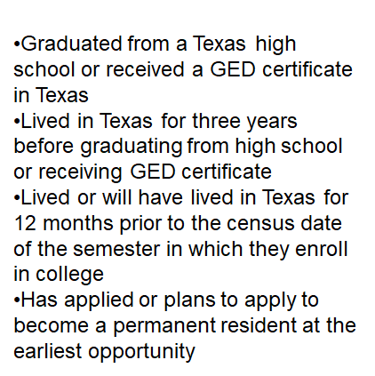
Senate Bill 1528 (TASFA)
Notes:
The TASFA provides an opportunity for students who are not eligible for the FAFSA, but are Texas residents, and meet a select number of other requirements to still receive state and institutional aid.

Slide 12
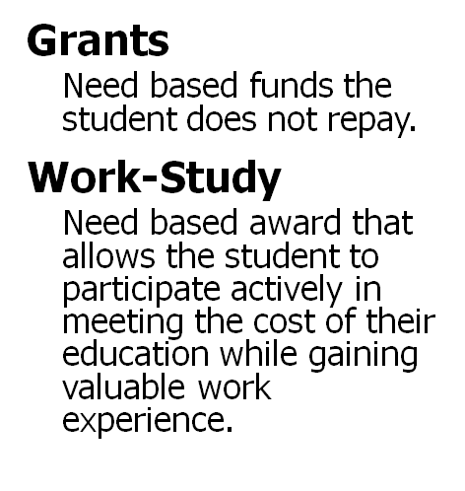
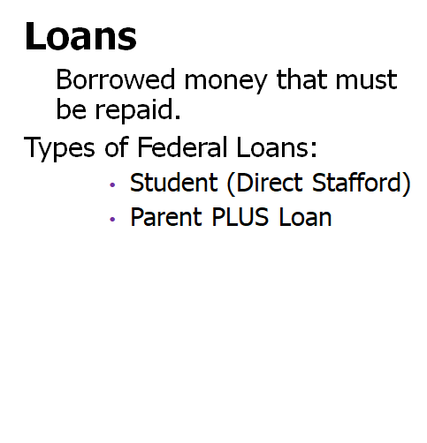
Types of Financial Aid
Notes:
There are three main types of financial aid that students can receive by completing the FAFSA: Grants, Loans, Work-Study. Grants are need based funds that students do not need to repay to the university. Loans are borrowed funds that students can use toward educational expenses that requires repayment. Lastly, work study is an opportunity for students to actively contribute to their education. These funds students earn grant valuable work experience as they help to pay down remaining costs.

Slide 13
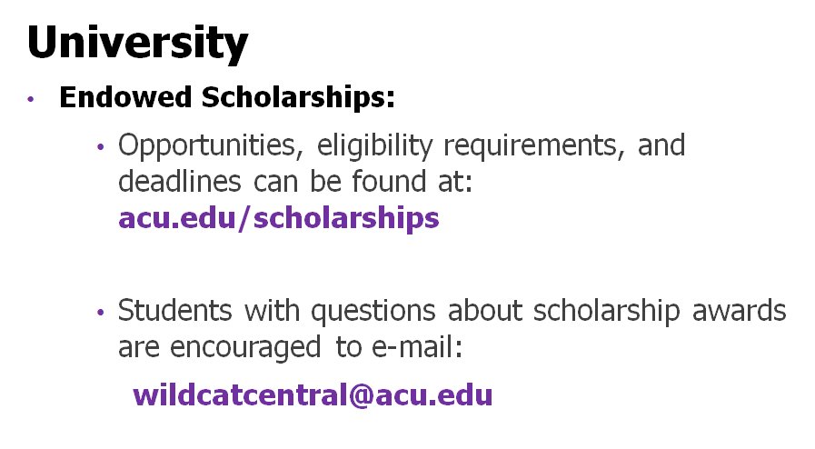
Scholarships
Notes:
As mentioned earlier, students have the opportunity to complete the endowed scholarship application yearly during the Spring term. This will pair students with additional university and department scholarship opportunities that become available.

Slide 14
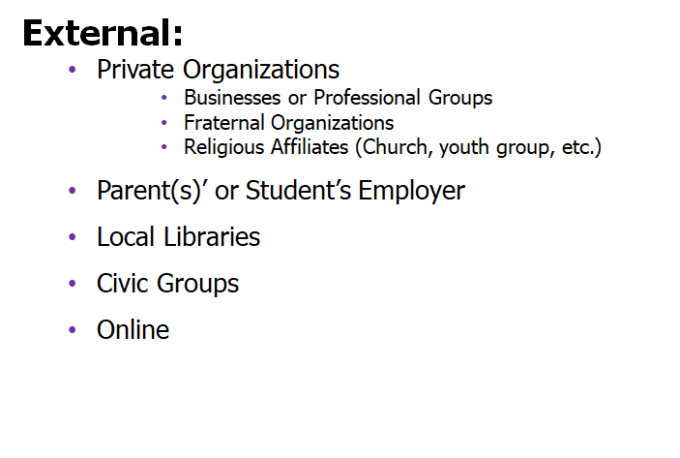
Scholarships Cont’d
Notes:
Additional scholarships are available to students outside of the university. Scholarships can be found through external organizations, employers, local libraries, civic groups, and online. We encourage students to follow the 70/30 rule. Spence 70% of your time searching for scholarship opportunities each week. The remainder of the week spend your 30% of your scholarship time applying for opportunities that you have found.

Slide 15
Is it possible to be awarded up to my COA?
Gift Aid (University and/or External Scholarships)
Grant Aid
Work Study
+ Loans (Student and Parent Loans)
Cost of Attendance ($53,740)
Notes:
One question students want to know is if it is possible to be awarded to their cost of attendance. The short answer is yes. With a combination of gift aid, grants, work study (jobs), and loans, students can have enough aid available to cover their entire estimated cost. Remember, the COA is an estimated total and families should always sit down and create a budget for each year the student will be attending.

Slide 16
What are my other options?

Slide 17
Work!!!
Notes:
Your income is your most powerful tool for which you can control when it comes to paying for college. HAve a discussion with your parents about any contribution that they are able to provide. From there, take time to calculate how much you would need to make/work in order to achieve your financial goal to attend school. Students have the ability to make up to $10,000 a year in income or more with intentionality. Most students do not take classes during the summer. During this period of time, work as much as possible to save income for the next year. While in school, working 20 hours a week students can make $2500 a semester working a job that pays $8 an hour. Take advantage of these opportunities as much as possible!

Slide 18
Limit unnecessary expenses

Slide 19
Notes:
Working is not the only way to save money for school. Along with increasing your income, look at ways to save money by monitoring cell phone usage (if you pay your own bill), buying used textbooks, limiting meals out, and creating a budget to stick to each month.

Slide 20
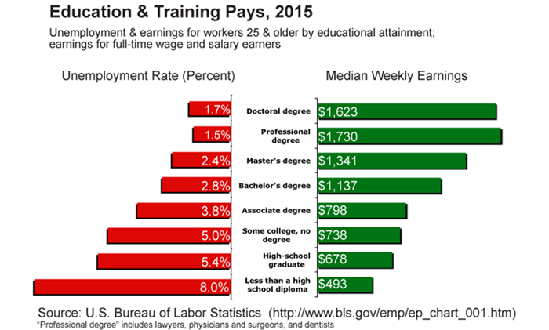
Education Pays!
Notes:
It pays to go to college over time! Take a look at the median weekly earnings based on the level degree you hold. Before starting school, look into your career field and determine your return on investment. After knowing your realistic salary projections, use this as a guide for the amount of loan debt you take out, and the money that you and your family contribute toward your education each year. Know the cost and the money you will make when it is all said in done when making your college financial plan.

Slide 21
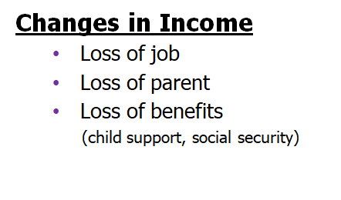
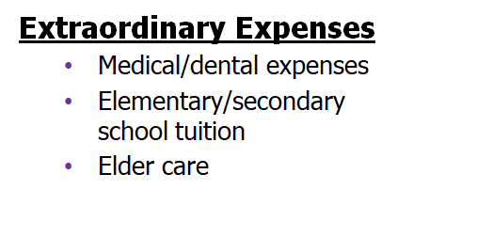
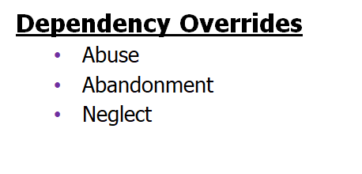
Who can we talk to about a special situation?
Notes:
We understand that over time things happen outside of your control that affects your ability to pay your bill. The financial aid team is here to help. If you are experiencing any situation that affects your ability to contribute financially, please contact your financial aid counselor to discuss options. Additionally, if there has been a change to your dependency status, please discuss this with your counselor to discuss any possible changes to your financial aid eligibility.

Slide 22
Need more information?
Wildcat Central Office Hours:
•Monday-Friday, 8-5pm
Wildcat Central Phone Number:
•(325) 674-2300 Direct
http://www.acu.edu/admissions-aid/undergraduate/financial-aid.html
Notes:
Please let us know if you have any questions or concerns that we could assist you with.

